Slide 1

Welcome to Bioinformatics Club
Mtg no. 1 Sept. 20th 2021

Slide 2
What is Bioinfomatics club?
Space/Place for 'us' to come together and...
Learn basics of bioinformatics
Share our knowledge of Computer Science, Biology and Bioinformatics
Discover new tools/techniques/ideas/.../passions that drive our research/studies

Slide 3
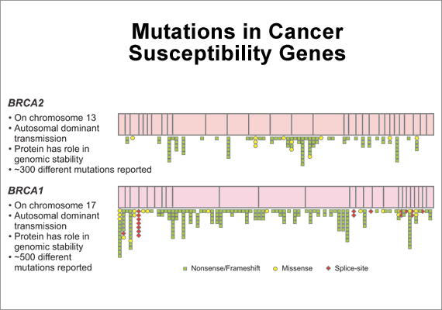

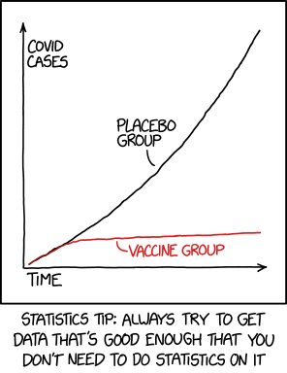
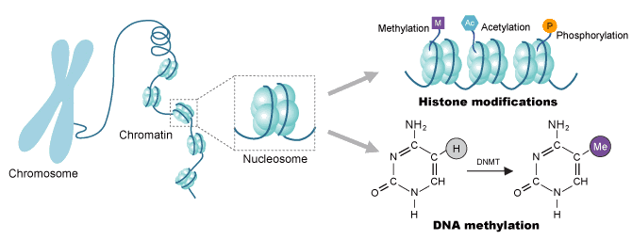
What is bioinformatics?
bool success = false;
int inventory = 5;
opponent = abra
for( int pokeball = 0; pokeball <= inventory; pokeball++) {
success = AttemptCatch(enemy,odds, windspeed, pokeball);
if(success){
inventory = inventory – pokeball;
Exit(0);
}
}
Biology
Computer Science
Chemistry
Statistics

Slide 4
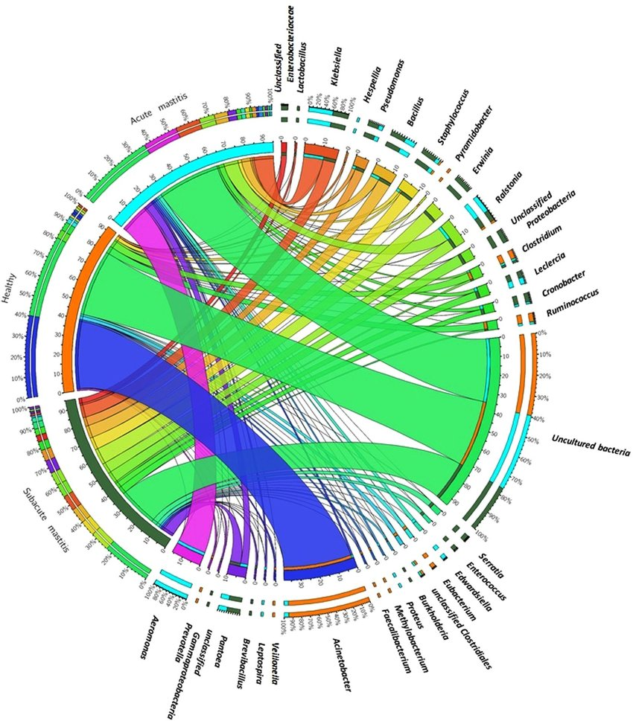
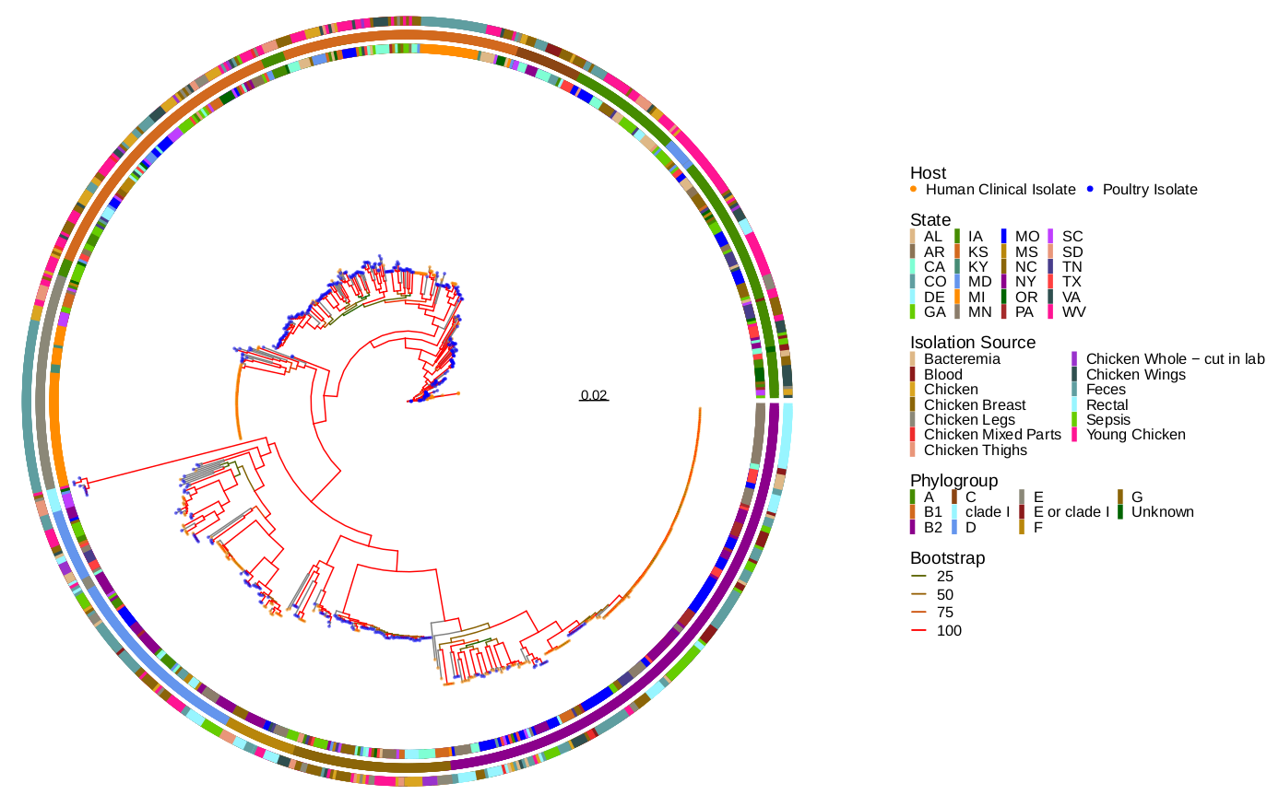
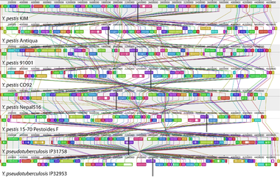
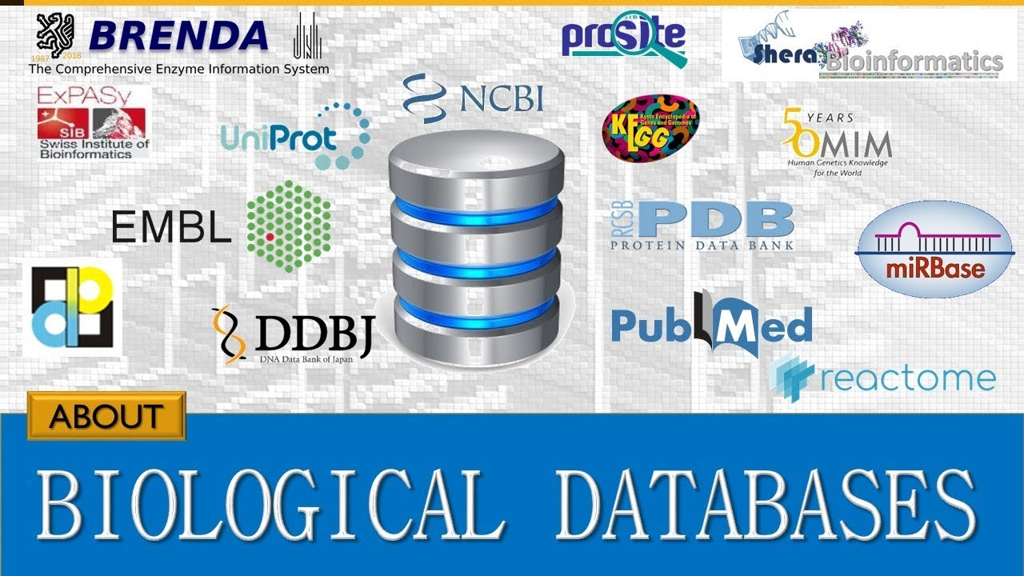
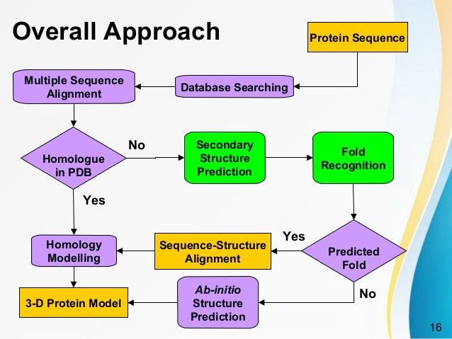
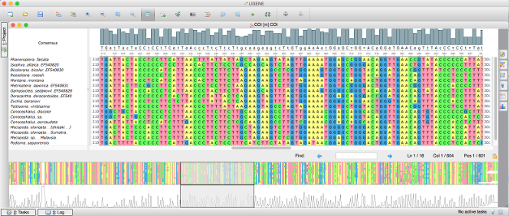
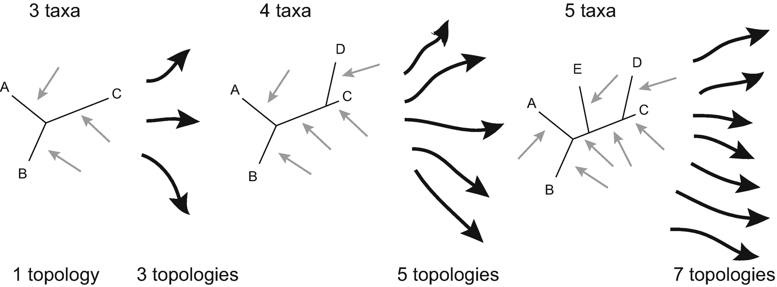
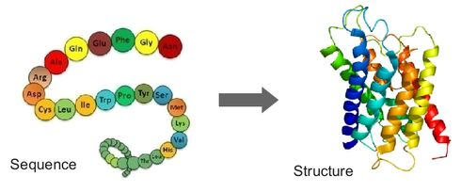
What is bioinformatics?
Biological databases
Multiple Sequence Alignment
Structural prediction tools
Molecular phylogenetics
Visualization
Comparative genomics
Computational Molecular Evolution

Slide 5


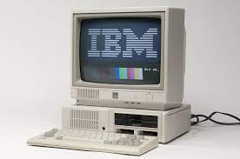





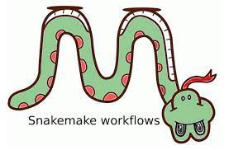

How one does bioinformatics
1) Ask a scientific question
2) Generate a hypothesis based on your background knowledge
3) Test that hypothesis
4) Accept or reject that hypothesis
Find an existing tool to aid in your hypothesis testing:
Create a novel tool/pipeline to aid in your hypothesis testing:
Win Science!

Slide 6
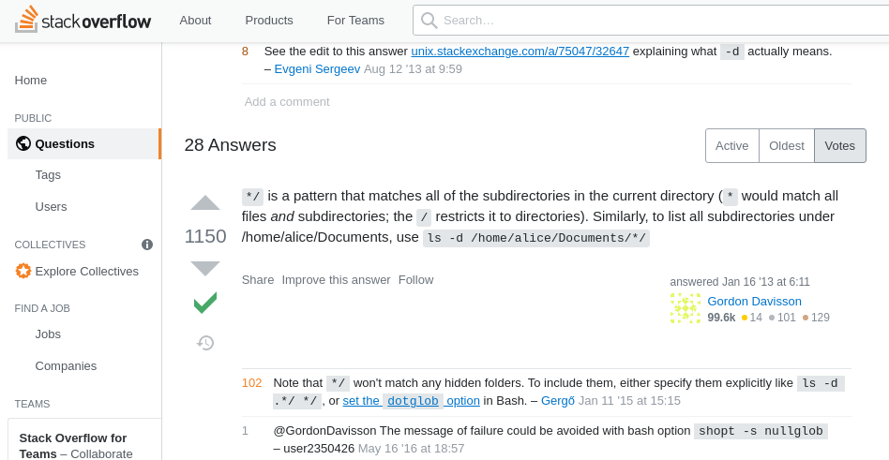
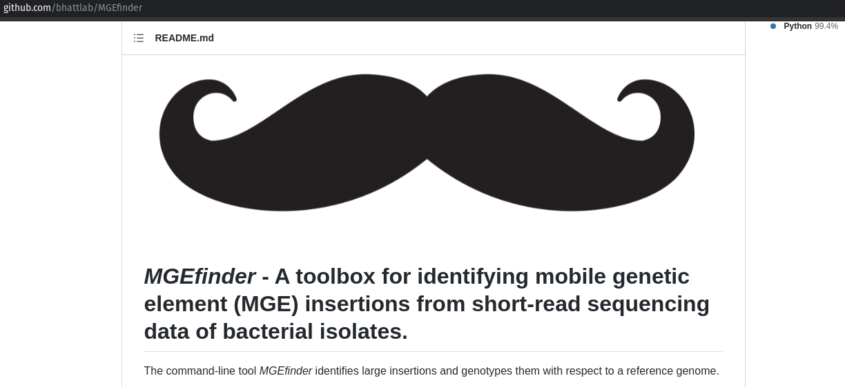
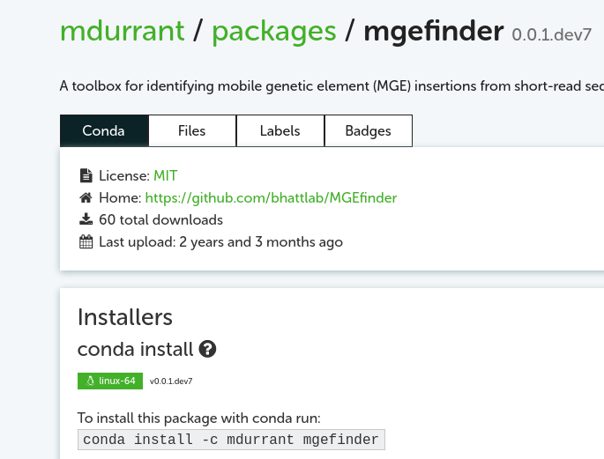
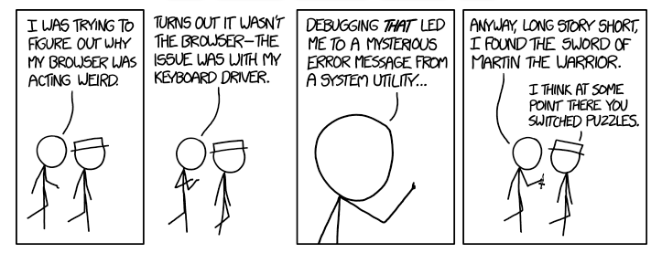
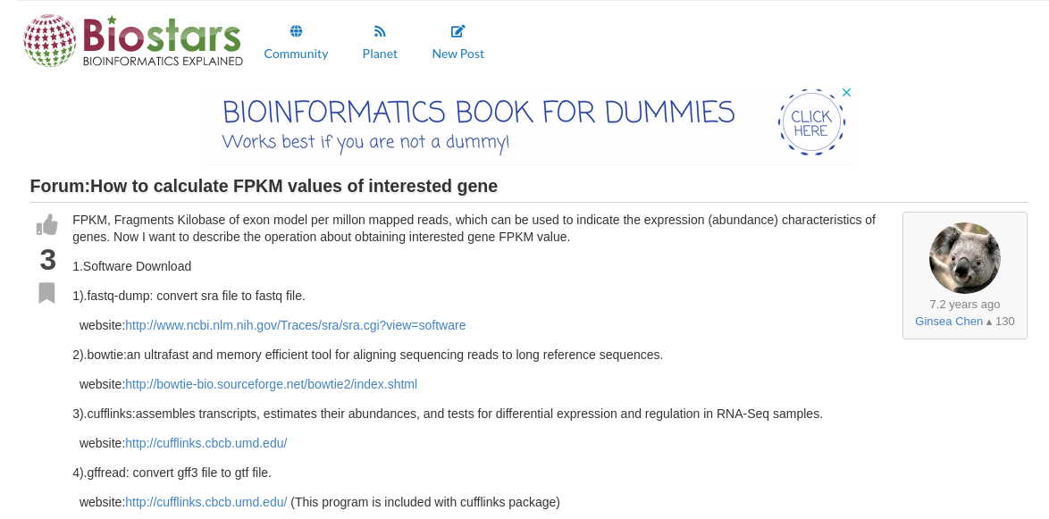
How one really does bioinformatics
4) Try on test data
1) Find a tool
..Debug..
2) Download the tool
5) Try on test data
3) Spend rest of day getting the dependencies to work/..../install
..Debug..
5) Try on real data
..Debug..
6) Find a new tool and try again
..Debug..

Slide 7
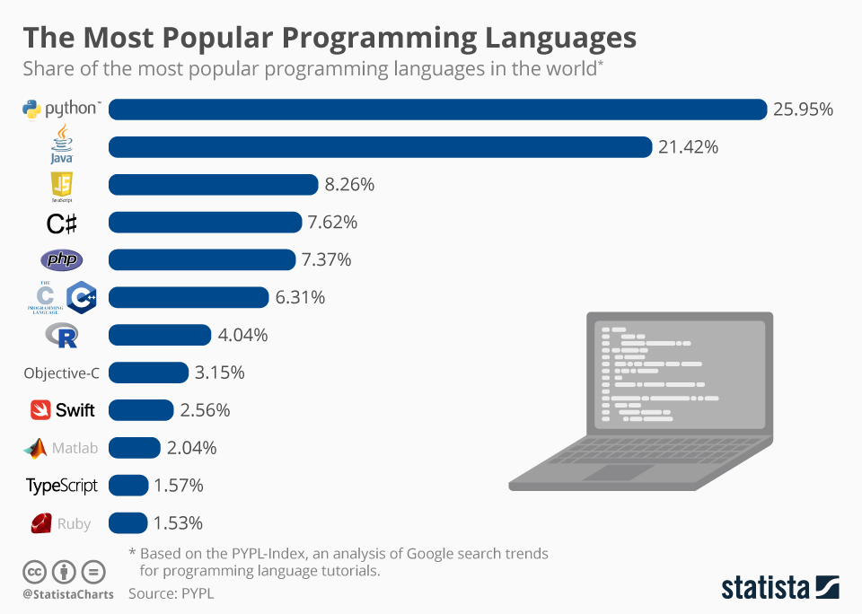
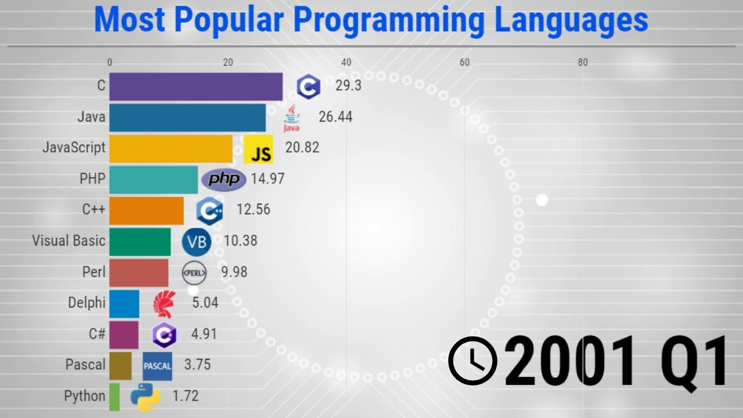
"What programming language should I start with?" "What is my problem and how can I solve it?

Slide 8

Bioinformatics job market
Google Jobs -> "Bioinformatics Jobs" -> Work-From-Home -> 300+ Jobs
Google Jobs -> "Bioinformatics Jobs" -> 200mi from FOCO -> 100+ Jobs
Post-doc bioinformatics
High-demand
$50k – 80k
Usually prefer PhD or Masters +3-5 years exp.
TONS of work-from-home opportunities
Bioinformatics 2021 summary
Avg. Salary $75k – 107k ("technician" - > "engineer")
Avg. Hourly $52/hr
(me constantly scanning Indeed/Google... many grains of salt)

Slide 9

Bioinformatics job market
(me constantly scanning indeed... many grains of salt)
Skillz:
Programming/computation
Popular languages
Python (comp. And viz.)
R (comp. And viz.)
Bash
SQL (database)
HPC/AWS
Docker
Git
Perl, C/C++, MATLAB, FORTRAN,Java
Soft​
Communication​
Teamwork ​
Data presentation​
Experts/layperson

Slide 10
Resources
Huge collection of CS/Bioinformatics Problems
Huge Collection of CS/Mathematics based Problems
MIT OCW Computational Biology
Manolis's Youtube page - Biology/CS/Bioinformatics/Theory.......
MIT OCW Computer Science
MIT OCW CS Algorithms by the Algo God, Erik Demaine
MIT OWC Mathematics for CS
MIT OCW offers all video lectures, course material, exams, homework, lecture notes,…, & solutions to those
Pine Biotech Youtube – lots of bioinformatics 20 min to 1+ hrs

Slide 11
To Do
Club Roles
*Financial Officer
Vice President
Secretary

Slide 12
Welcome to Bioinformatics Club
Mtg no. 3 Nov. 15th 2021
Join us and download material:
https://discord.gg/UAFUBmzV

Slide 13
To Do
Club Roles
*Financial Officer
Vice President
Secretary
Topics
Start playing with command line

Slide 14
Topics
Quality control of sequencing data
Bacterial Genome Assembly
Machine Learning
Debugging!
Data Wrangling: Intro to R and Tidyverse
….
Dec
Jan
Feb
March
April
May

Slide 15
The Plan
Linux environment
Navigating the command line (https://cheatography.com/davechild/cheat-sheets/linux-command-line/)
How to download bioinformatics tools
Common bioinformatics file types

Slide 16
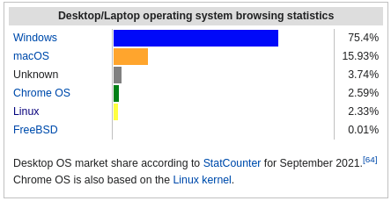
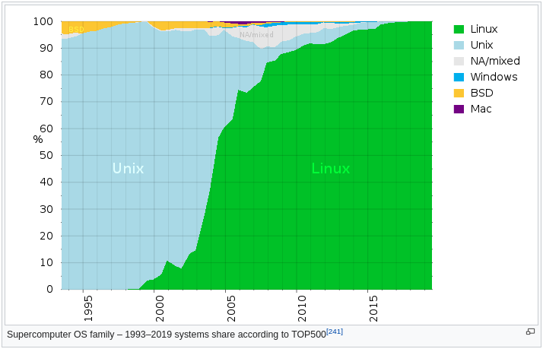
Linux environment
Windows machines
Windows subsystem for Linux
https://docs.microsoft.com/en-us/windows/wsl/install
Virtual Machine
https://itsfoss.com/install-linux-in-virtualbox/

Slide 17
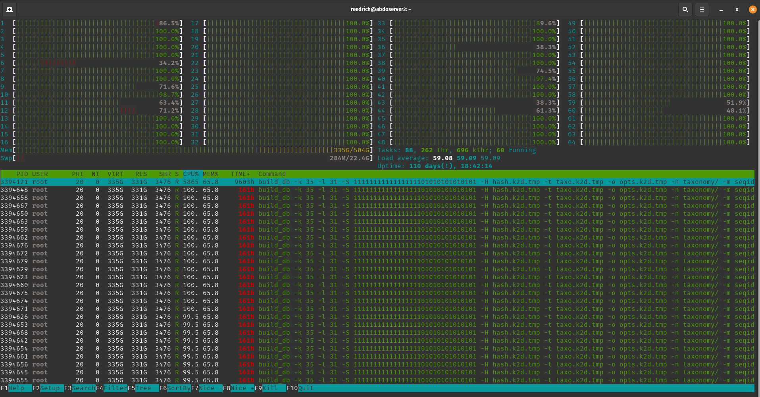
The command line – first glance
Open terminal
View resources: htop
Linux: apt install htop
Mac: brew install htop

Slide 18

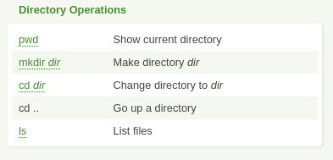

The command line – Navigating
Download material from Discord: https://discord.gg/UAFUBmzV
Create Bioinformatics-Club Directory
Navigate to Discord files
Move Discord files to Bioinformatics-Club/

Slide 19
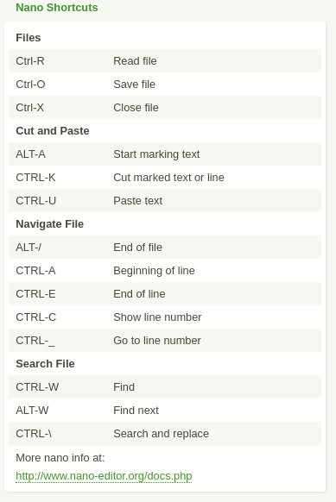
The command line – Viewing
Popular options to view WHOLE file:
nano filename
vim filename
View portion of file:
head filename
less filename
Create text file
View text file
nano
head
less

Slide 20
Bioinformatics tools
Tool for today: samtools
Choose a path to install: GitHub or BioConda
Install samtools

Slide 21
5 genomics file formats you need to know
View FASTA
less Ecoli-K-12.fasta
cat Ecoli-K-12.fasta | grep ">" | less
View FASTQ
less illumina_R1.fastq
View BAM
samtools view sample.bam | less
View VCF
Less sample.vcf
View BED
less sample.bed
FASTA
FASTQ (https://support.illumina.com/bulletins/2016/04/fastq-files-explained.html)
BAM (https://samtools.github.io/hts-specs/SAMv1.pdf)
VCF (https://faculty.washington.edu/browning/beagle/intro-to-vcf.html)
BED (https://bedtools.readthedocs.io/en/latest/content/general-usage.html)

Slide 22
5 file formats: Example workflow
some_aligner –reads MinIon.fastq --reference Ecoli-K-12.fasta > read_alignments.bam
some_variant_caller –reads read_alignments.bam --reference Ecoli-K-12.fasta > variants.vcf

Slide 23
References
OMGenomics – Awesome YouTuber/Google Genomics/Data Vis
https://omgenomics.com/getting-started-bioinformatics/
Bioinformatics file formats: https://www.youtube.com/watch?v=MrVpn0vpIYU

Slide 24
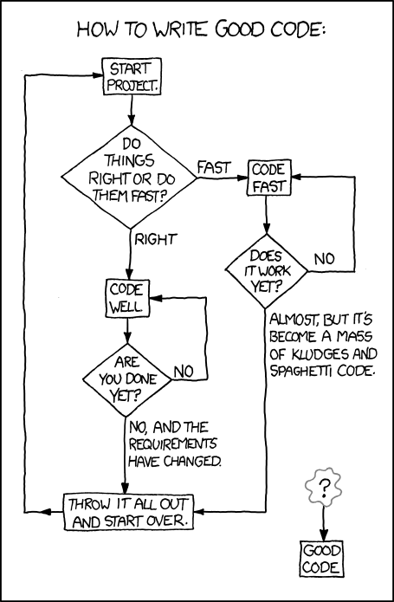
Next Meeting
Pick a date
Dec 13? Dec 20?
Topic: Next generation sequencing
Quality Control of raw data
FastQC, MultiQC, Trimmomatic, CutAdapt
(Maybe) Start Bacterial Genome Assembly

Slide 25
Welcome to Bioinformatics Club
Mtg no. 4 DEC. 13th 2021
Join us and download material:https://discord.gg/HmKgkZVa

Slide 26
Bioinformatics Positions
Financial Advisor
Vice President
Secretary

Slide 27
Conda
Conda is an open source package management system and environment management system that runs on Windows, macOS and Linux.
Conda quickly installs, runs and updates packages and their dependencies.
Conda easily creates, saves, loads and switches between environments on your local computer.
It was created for Python programs, but it can package and distribute software for any language.

Slide 28
Conda - Environments
3 ways to create a conda environment
Create conda environment from (yml) file
conda create --name New_Env
conda create -n py27_Env python=2.7
conda create -n fastqc_Env -c bioconda fastqc trimmomatic
conda env create -f conda_env.yml
Ex) https://github.com/arpcard/rgi/blob/master/conda_env.yml
List current conda environments
conda info --envs

Slide 29
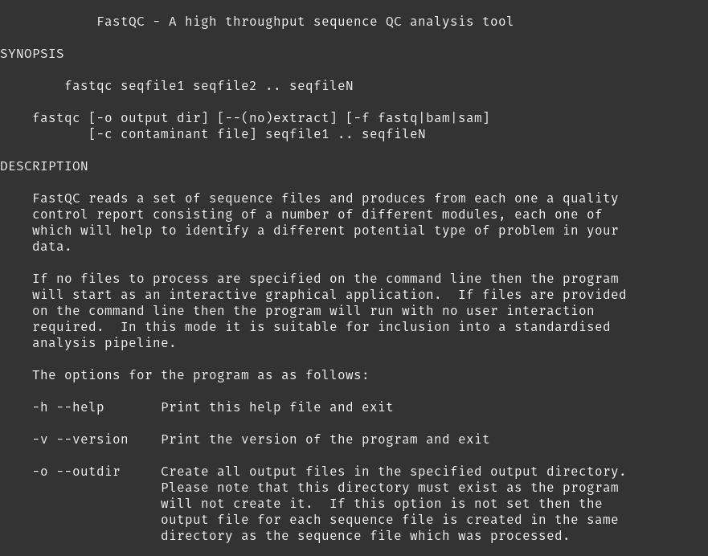
Fastqc usage
conda install -c bioconda fastqc
Quick test) fastqc –h
Should get help menu:

Slide 30
Running fastqc on Illumina2-example files
htop
Check what else is running
Decided # of threads (CPUs) you will use
fastqc Illumina2_R1.fastq.gz Illumina2_R2.fastq.gz -t 2

Slide 31
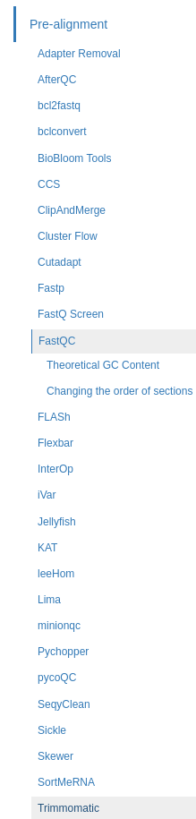
Running Multiqc on fastqc output = Prettier
Works with many bioinformatics software:
conda install -c bioconda -c conda-forge multiqc
https://multiqc.info/docs/
First way)
git clone https://github.com/ewels/MultiQC.git
cd MultiQC
pip install .
https://multiqc.info/docs/#using-multiqc
Second way)

Slide 32
Running Multiqc on fastqc output = Prettier
Test install:
Multiqc –h
Look at help menu: usage
Run multiqc:
multiqc <directory>
If in directory with fastqc (.html results):
multiqc .
"A modular tool to aggregate results from bioinformatics analyses across many samples into a single report."

Slide 33
Welcome to Bioinformatics Club
Mtg no. 5 Feb. 21st 2022
Join us and download material:
https://discord.gg/49NGa3h7

Slide 34
Feb. 21st 2022
Pizza
Bio-Cybersecurity Student Challenge
Quality control of sequencing data (continued)
Up next...

Slide 35
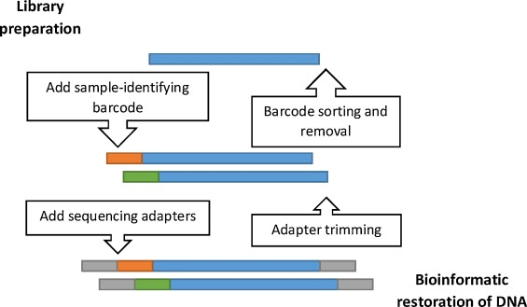
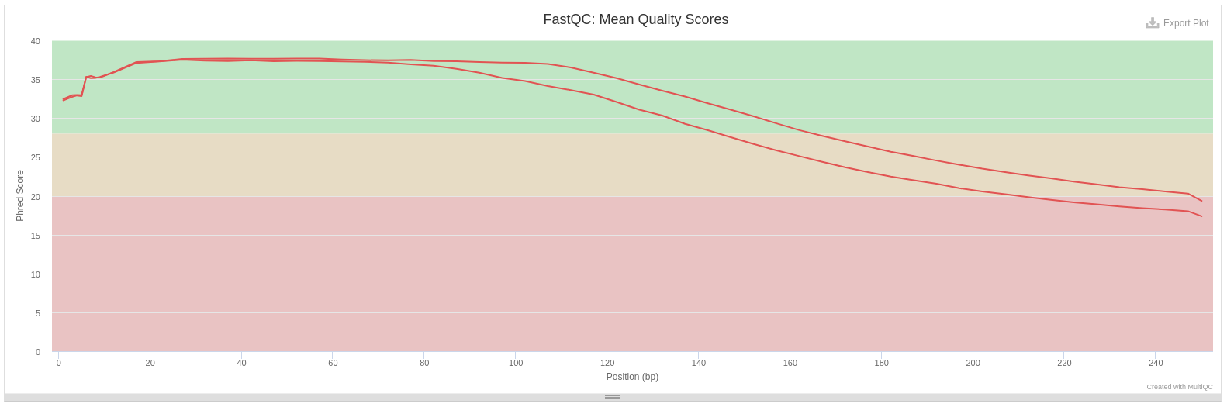
Motivation

Slide 36
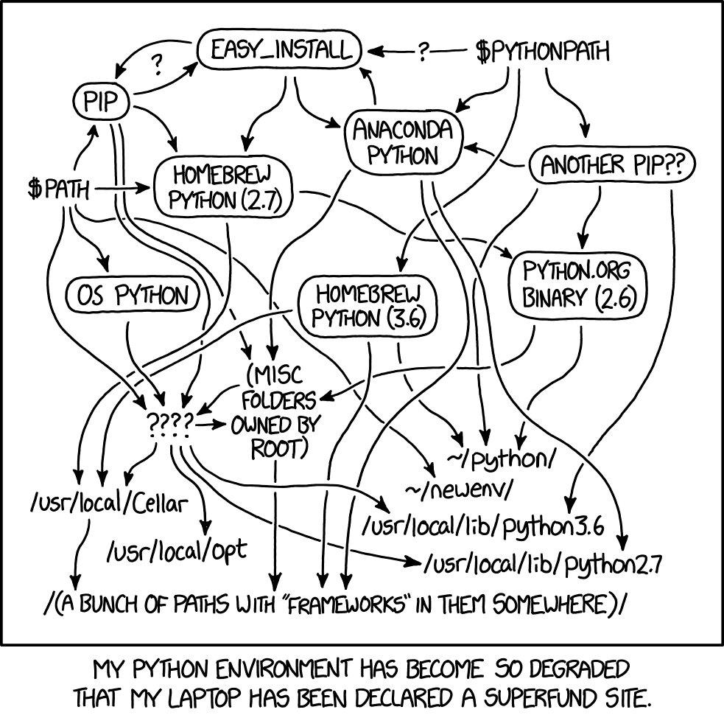
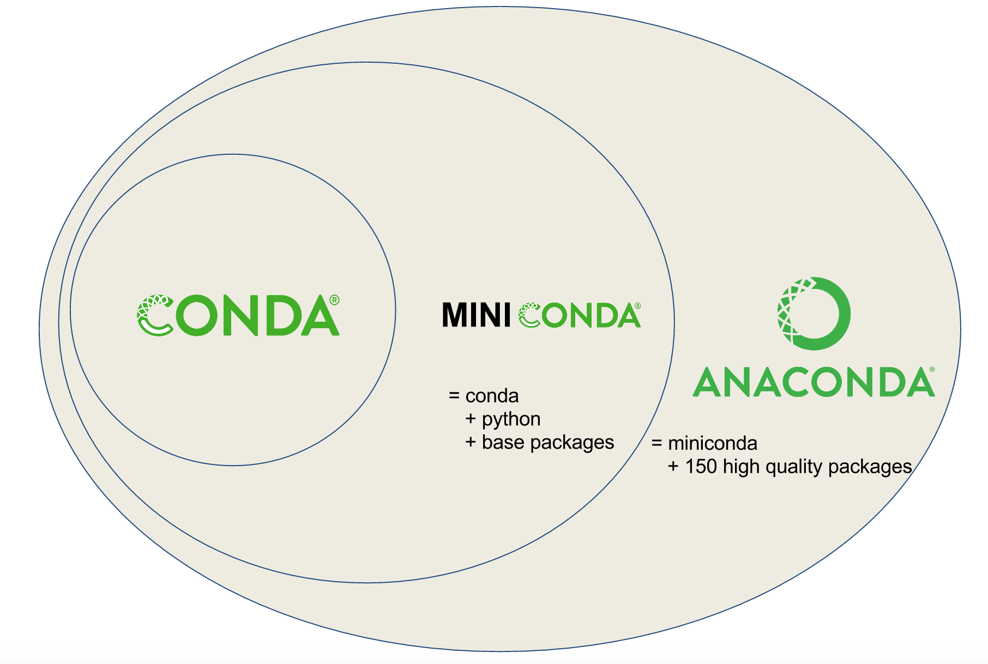
Conda

Slide 37
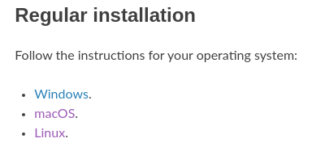
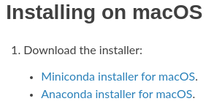
Install Anaconda/Miniconda/Conda
https://docs.conda.io/projects/conda/en/latest/user-guide/install/index.html
First way)
Second way)
wget https://repo.anaconda.com/miniconda/Miniconda3-latest-MacOSX-x86_64.sh -O ~/miniconda.sh bash ~/miniconda.sh -b -p $HOME/miniconda

Slide 38
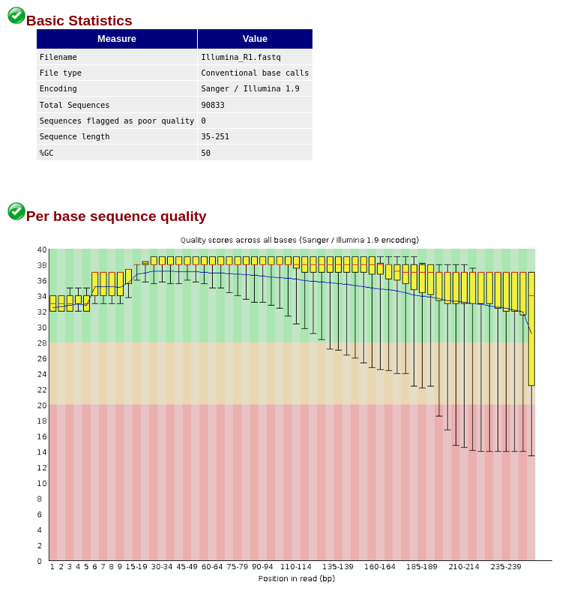
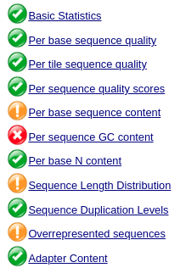
Install FastQC – What is Fastqc?
conda install -c bioconda fastqc
Quick test) fastqc –h
Should get help menu

Slide 39
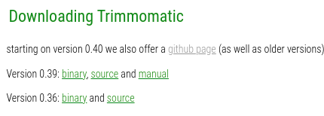
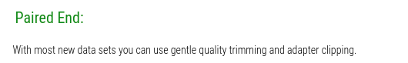
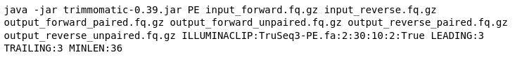
Trimming sequences for quality

Slide 40
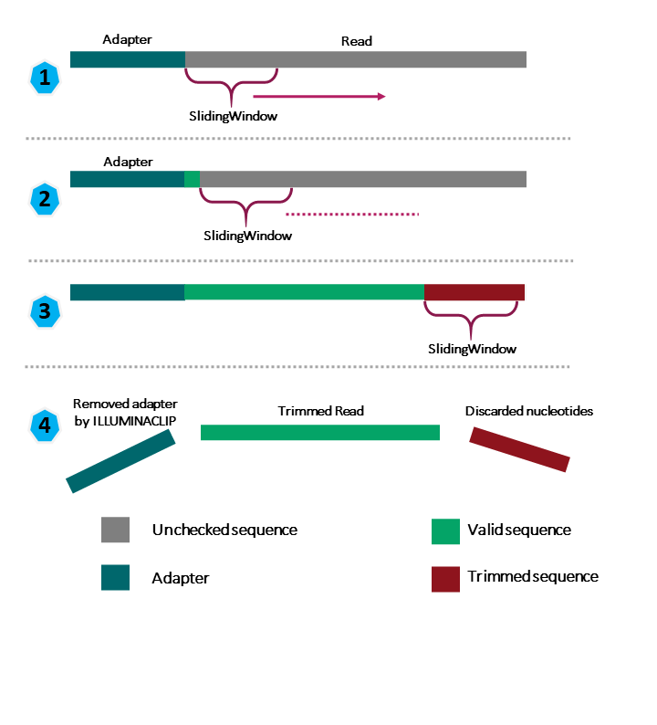
Trimming sequences for quality
Trimmomatic: SLIDINGWINDOW

Slide 41
Trimming sequences for quality
java -jar trimmomatic-0.39.jar PE Illumina2_R1.fastq.gz Illumina2_R2.fastq.gz Illumina2_R1_paired.fastq.gz Illumina2_R1_unpaired.fastq.gz Illumina2_R2_paired.fastq.gz Illumina2_R2_unpaired.fastq.gz LEADING:3 TRAILING:3 MINLEN:36 SLIDINGWINDOW:4:20
Optional adaptor trimming:
ILLUMINACLIP:TruSeq3-PE.fa:2:30:10:2:True

Slide 42
Trimming sequences for quality
java -jar trimmomatic-0.39.jar PE Illumina2_R1.fastq.gz Illumina2_R2.fastq.gz Illumina2_R1_paired.fastq.gz Illumina2_R1_unpaired.fastq.gz Illumina2_R2_paired.fastq.gz Illumina2_R2_unpaired.fastq.gz LEADING:3 TRAILING:3 MINLEN:36 SLIDINGWINDOW:4:20
Run trimmomatic ->
java -jar trimmomatic-0.39.jar
PE Illumina2_R1.fastq.gz Illumina2_R2.fastq.gz
Illumina2_R1_paired.fastq.gz Illumina2_R1_unpaired.fastq.gz
Illumina2_R2_paired.fastq.gz Illumina2_R2_unpaired.fastq.gz
LEADING:3 TRAILING:3
MINLEN:36
SLIDINGWINDOW:4:20
Input files ->
Output forward ->
Output reverse ->
Gentle trimming ->
Min length ->
Trimming ->
Optional adaptor trimming:
ILLUMINACLIP:TruSeq3-PE.fa:2:30:10:2:True

Slide 43
Trimming sequences for quality
Did it work?
Run fastqc:
fasqc Illumina2_R1_paired.fastq.gz Illumina2_R2_paired.fastq.gz
(Optional)
Run multiqc to make prettier output: (In same directory as fastqc *.html files)
multiqc .

Slide 44
Welcome to Bioinformatics Club
Mtg no. 6 March. 31st 2022

Slide 45
Machine learning
http://www.r2d3.us/visual-intro-to-machine-learning-part-1/

Slide 46
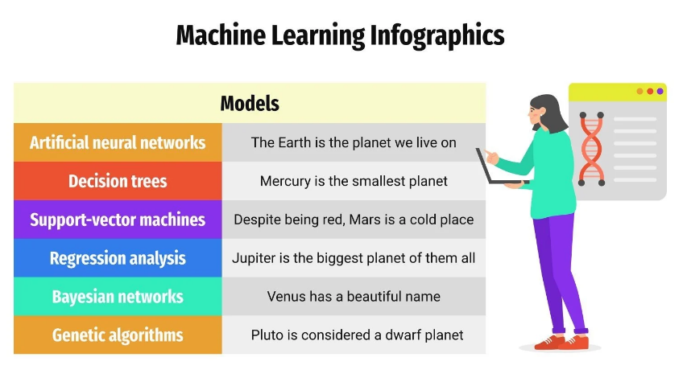

Slide 47
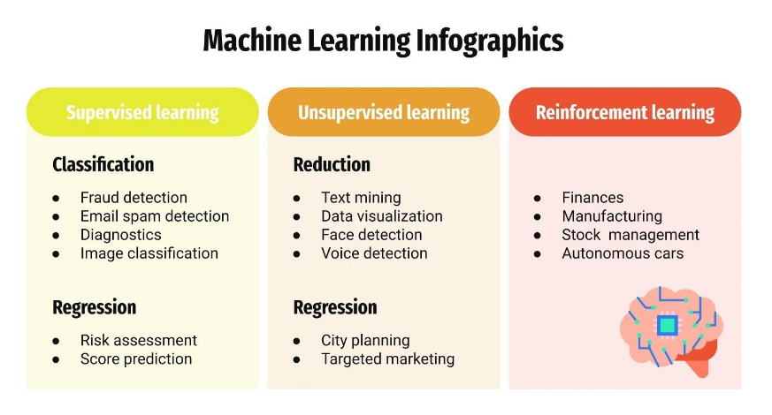

Slide 48
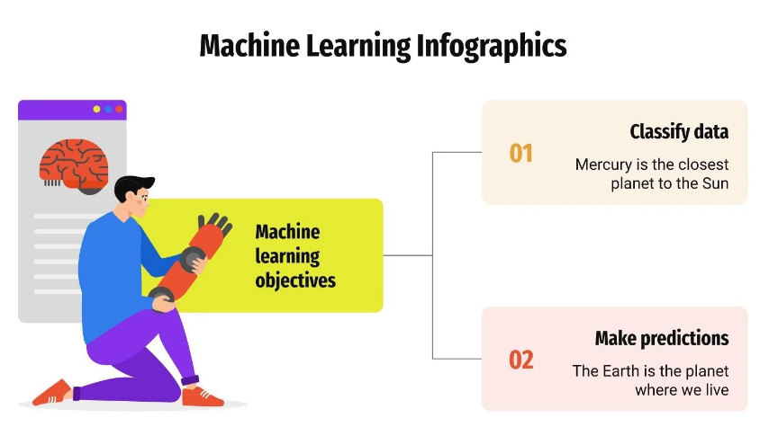

Slide 49
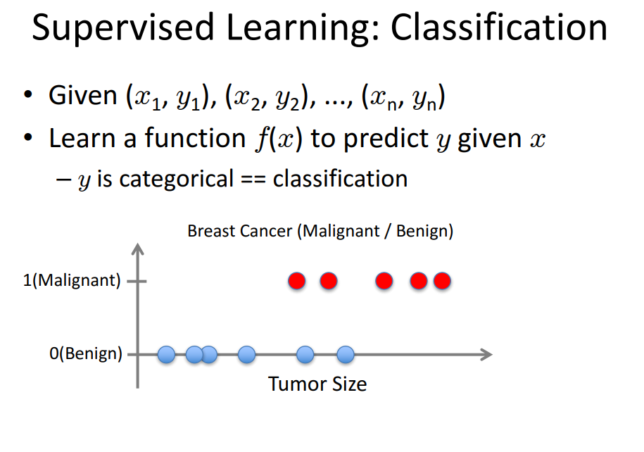

Slide 50
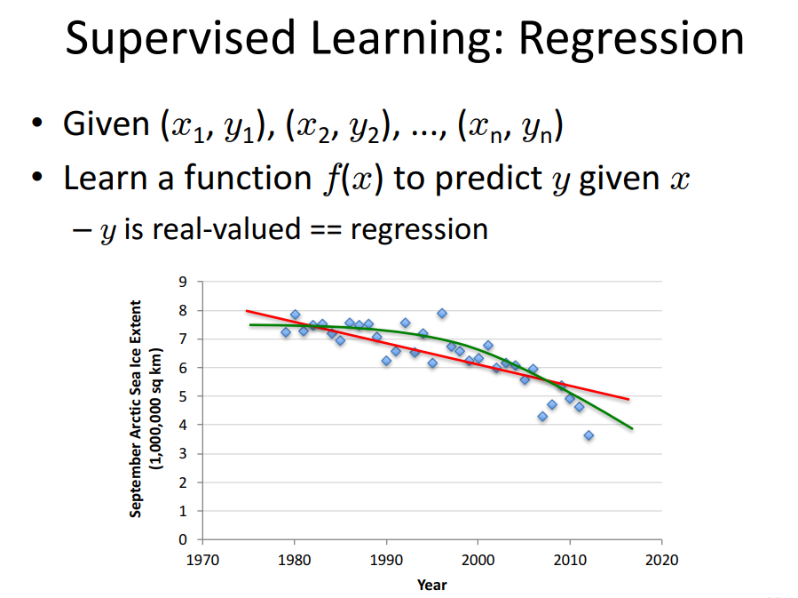

Slide 51
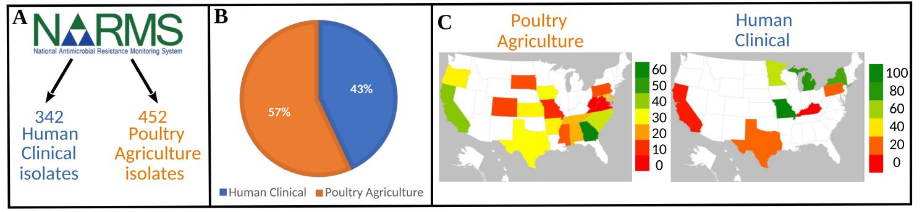
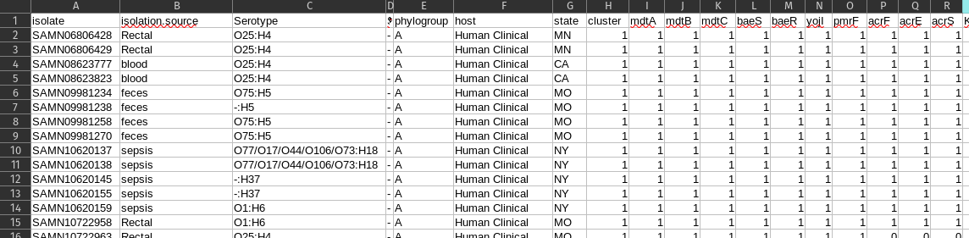
Classification Example
Data: Isolates and presence absence table of genes
Goal: Classify isolates into their respective Host sources (Human vs. Poultry Agriculture)
Approach: Use Random Forests

Slide 52

Classification example: Random Forests

Slide 53
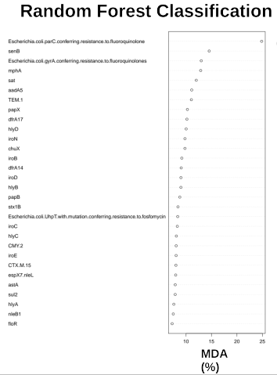

Slide 54
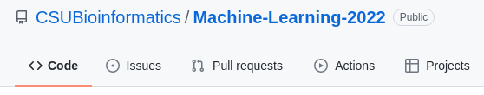
Classification tutorial: Evan Conaway

Slide 55
Welcome to Bioinformatics Club
Mtg no. 7 April. 18 2022

Slide 56
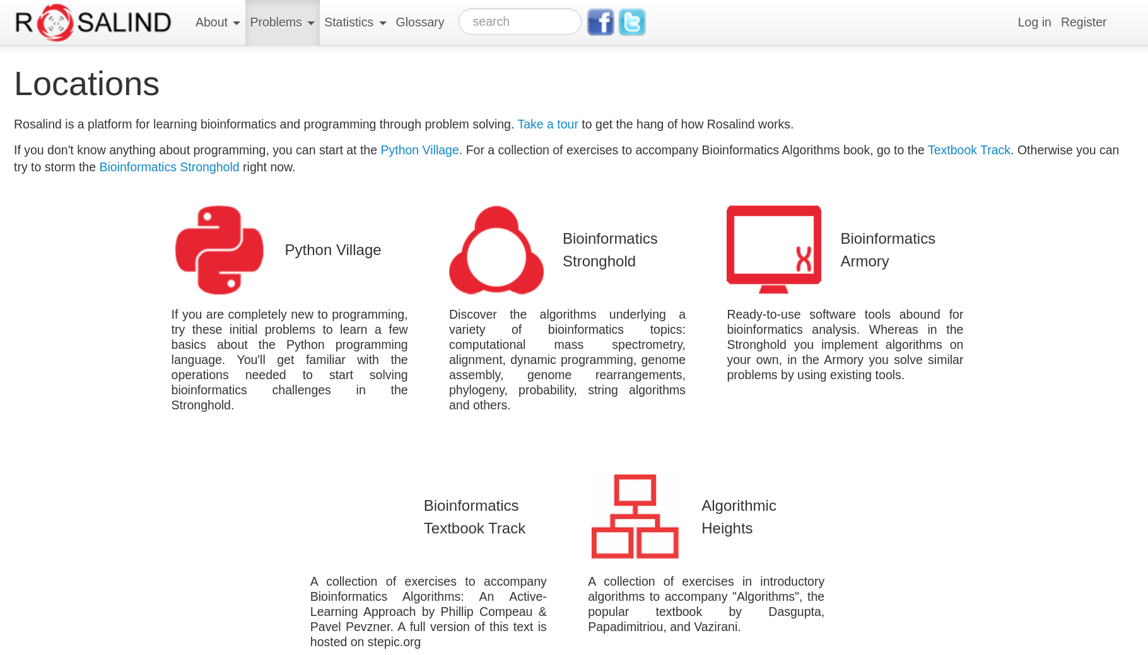
Coding basics – www.rosalind.info

Slide 57
Problem #1 – Counting DNA nucleotides
Given: DNA string of nucleotides – ex: s = "ATCG"
Output: count of 'A', 'T', 'C', 'G' on a single line with spaces between – ex: "1 1 1 1"

Slide 58
First, python
Command line
Save file as xxxx.py
Run via command line with: python xxxx.py
Online python IDE
https://www.online-python.com/

Slide 59

Approach: toolkit
Printing
age = 29
print("Reed:", age)
Looping
For loops
for i in range(start, end):
Print(DNA[I])
While loops
i = 0
While i < end:
print(i)
i= i + 1
Strings
s = "actg"
s[0] = "a"
len(s) = 4
If statements
a = 1
b = 10
if a < b:
print("a is less than b")
If Else statements
If a < b:
print(a)
elif a == b:
print("a is equal to b")

Slide 60
Problems to try
Transcribing DNA into RNA
Translating RNA into Protein
Computing GC Content
Complementing a Strand of DNA
Counting Point Mutations
Transitions and Transversions
Finding a Motif in DNA

